Slide 1
Economics and Computations – Project Presentation
Leduc Poker Solver
11thJuly 2020
Luca Carminati
Teresa Costa Cañones
Robert Stefano Chinga

Slide 2
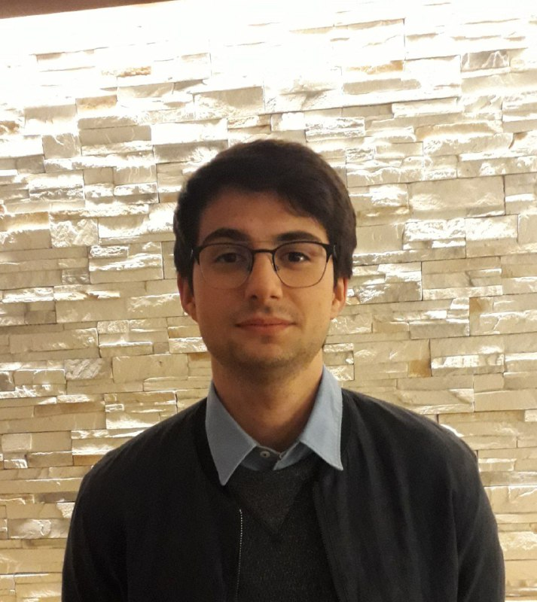


Project authors
Luca Carminati
Laurea Magistrale
Computer Science and Engineering
Teresa Costa Cañones
Laurea Magistrale
Telecommunication engineering
Robert Stefano Chinga
Laurea Magistrale
Computer Science and Engineering​

Slide 3

OUTLINE:
1
ABSTRACTION
2
NASH EQUILIBRIUM APPROXIMATION
3
STRATEGY REFINEMENT

Slide 4
OUTLINE:
1
ABSTRACTION
2
NASH EQUILIBRIUM APPROXIMATION
3
STRATEGY REFINEMENT

Slide 5
Abstraction
Introduction
Problem : the original game tree may be very large and it makes the computation of a Nash Equilibrium infeasible.
Solution : Use an Abstraction to reduce the original game tree into a new one of a reasonable size without losing much information from the original structure.
Then find a Nash Equilibrium for the new game tree and remap the result into the original.
Our approach to find the abstraction :
Game tree analysis : We analysed the structure of the game tree (Leduc Poker), trying to find some similarities between each sub tree and features regarding the information sets.
Research : We read papers to see different abstractions and different approaches.
Discussion : We discussed different ways to abstract the original game tree and we chose the abstraction.
Implementation and evaluation : After having chosen the abstraction, we implemented it and we analysed the result.

Slide 6
Abstraction
Game tree analysis
Regarding the results about the game tree analysis:
The first and the second round have a similar structure. The only differences are the following:
- In the first round some path lead to a chance node. These chance nodes represent the transition between the first and the second round in which the dealer shows the common card.
- In the second round a player can raise 4 chips while in the first round only 2.
The next slide shows the structure of the first round by considering the hand QK (left side) and the structure of the second round by considering the same subtree after the following sequence of actions : Player1 - Check and Player2 – Check (right side).

Slide 7
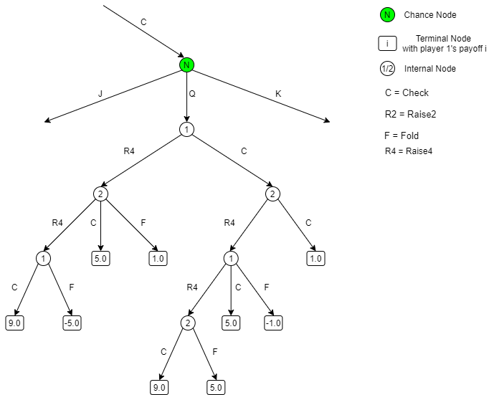
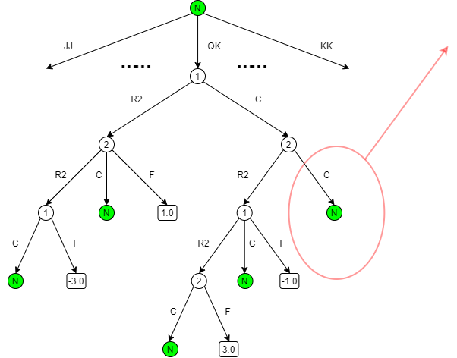
Abstraction
Game tree analysis

Slide 8
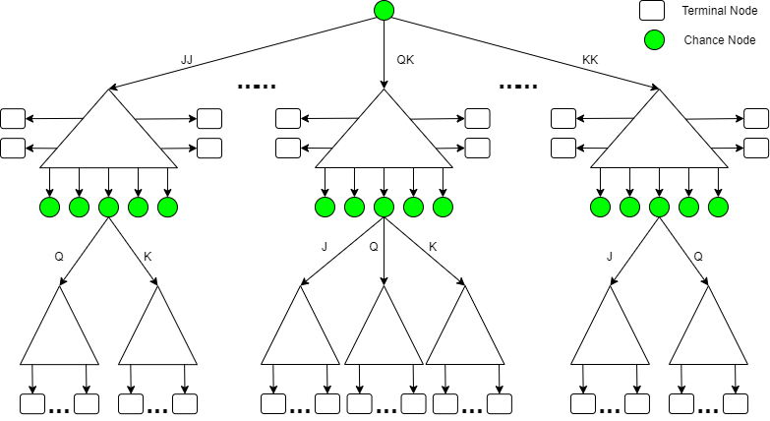
Abstraction
Game tree analysis
So it is possible to imagine the original game tree :
Each subtree has a similar structure. For instance, note the hand JJ and the hand KK.
Generally, each subtree differs from one to another for the payoffs and for the internal chance nodes.
We need to pay attention when we merge two subtrees!

Slide 9
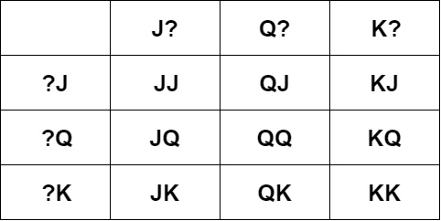
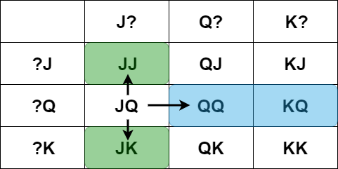
Abstraction
Game tree analysis – Information Sets
What about information sets?
Each subtree can be associated to two information sets : one of player 1 and the other of player 2. This happens because each player cannot see the private card of the adversary.
This association can be represented by means of a matrix. Each row indicates an information set of player 2 while each column an information set of player 1. Each entry of the matrix represents a hand and the information set associated to it.
By using this matrix we can see how the subtrees are connected to each other. For instance, the subtree JQ is connected to the subtrees JJ and JK due to player 1 (column J?) but it is also connected to the subtrees QQ and KQ due to player 2 (row ?Q).

Slide 10
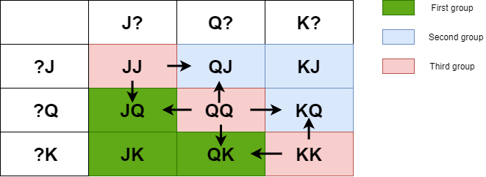
Abstraction
Research + Discussion
We came up with two ideas:
FIRST IDEA: Use k-means to group the subtrees with similar payoffs. Then create a representative tree for each group. In the end, create the new game tree using only the representative trees.
We found that a good number for k (so for the number of groups) was 3 : one group represents the situation in which the player 1 starts with a better card w.r.t. the player 2, another group represents the vice versa and the last one the situation in which both players have the same card.
Main problems:
Increasing the number of cards in Leduc Poker makes this abstraction coarser (25 subtrees in Leduc 5 vs 3 subtrees in the abstraction).
Loss of the meaning of the information sets :
Each group is connected to the other for both player1 and player2.

Slide 11
Abstraction
Card binning
SECOND IDEA: Card Binning
Basic idea: Group the cards by their strength and consider each group as a new card.
The procedure is the following :
Compute the strength of each card by using the expected value of the subtrees in which the card is played by player 1 (for instance, if we want to compute the strength of J in leduc3, we need to consider the subtrees JJ,JQ,JK).
Group cards with similar strength (the number of groups is chosen by us).
Now each group is considered as a new card and we substitute it in the game.
Group the subtrees of the original game tree that have the same name after the substitution.
The idea has its origin by reading the following paper Sam Ganzdriend and Tuomas Sandholm – «Potential-aware Imperfect-Recall Abstraction».
Note: Our approach is much simpler than the one discussed in the paper and it is adapted to Leduc Poker.

Slide 12
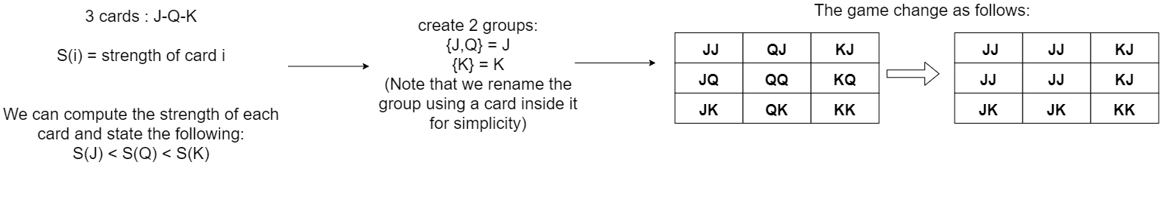
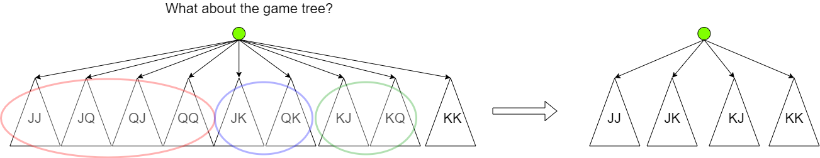
Abstraction
Card binning example
Now let’s consider an example with Leduc3:

Slide 13
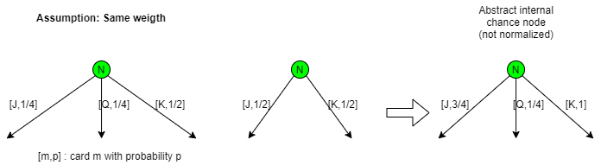
Abstraction
How to merge subtrees
As said in the game tree analysis, we need to be careful when we merge two or more subtrees to obtain a new subtree :
With respect to the payoffs :The payoffs of the new subtree will be the average of the payoffs of the subtrees belonging to the same group.
With respect to the internal chance nodes: The new internal chance node will have as set of actions the union between the actions of the internal chance nodes belonging to the original subtrees, and the probability of each action of the abstract chance node will be the sum of the probabilities for such action from the original chance nodes (each probability weigthed by the probability to be in that specific subtree) and then normalized.
Note: successively cards will also be binned at this level

Slide 14
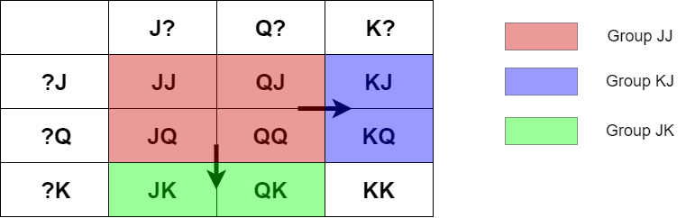
Abstraction
Final consideration
The card binning abstractions allowed us to solve the problems of the first idea.
In particular, the abstraction maintains the meaning of the information sets.
The abstract subtree JJ is connected to the abstract subtree KJ (due to player 2) but also it is connected to the abstract subtree JK (due to player 1) .

Slide 15
OUTLINE:
1
ABSTRACTION
2
NASH EQUILIBRIUM APPROXIMATION
3
STRATEGY REFINEMENT

Slide 16
NASH EQUILIBRIUM APPROXIMATION
Introduction
GOAL:
Find a Nash Equilibrium in 2-player zero-sum game taking into account that such game tree is big.
Find the blueprint strategy (solve the abstracted game).
PROBLEM:
It is not feasible to do linear programing of a big game tree.
IDEA:
Perform techniques related to the minimization of regret.
Use the Counter Factual Regret minimization technique (CFR) to find which of the different strategies is more suitable for our game.

Slide 17
NASH EQUILIBRIUM APPROXIMATION
Introduction
Many options are possible:
CFR
CFR+
CFR+ averaged
CFR-BR
Discounted CFR
Each option need to be compared and find the one which has fewer time to converge and the more optimal strategy.
There are more options than the ones introduced.

Slide 18
NASH EQUILIBRIUM APPROXIMATION
Comparison between CFRs
 | CFR+ | CFR+ averaged | CFR-BR | Discounted CFR
Differences with CFR | Converges faster than CFR High compression ratio can be attained | Converges faster than CFR+ | Don’t need to abstract the game because needs less memory | Converges faster than CFR+
Decision:
CFR+ averaged because converges faster and have better performance.
Implemented accordingly to reference paper: http://arxiv.org/pdf/1407.5042v1
Comparisons:
In order to see which are the differences in a more visual manner it is used http://jeskola.net/cfr/demo/
Notes:
CFR-BR: https://poker.cs.ualberta.ca/publications/AAAI12-cfrbr.pdf
DCFR: https://arxiv.org/pdf/1809.04040.pdf

Slide 19
OUTLINE:
1
ABSTRACTION
2
NASH EQUILIBRIUM APPROXIMATION
3
STRATEGY REFINEMENT

Slide 20
Strategy Refinement
Introduction
PROBLEM:
Strategies produced by playing the abstracted game are OK-ish in the general case, but they lack effectiveness in the cases of hands made of cards which have been abstracted together.
This because different cards were made undistinguishable to simplify the game (card binning)
SO
Exploitability of Final Strategy can be further improved.
IDEA:
perform a REFINEMENT of the final strategy directly on the original game.
HOWEVER
Computational issues that pushed us towards abstracting the game are still present and must be solved.
We decided to solve them by considering only portions of the subgame at a time, while adopting strategy found in abstract game in the remaining parts of the game.

Slide 21
Strategy Refinement
Introduction
Many options are possible, we opted to implement some of them
CFR Refinement
Bias Refinement
Self Generative Refinement
InGame Refinement
Each of these Refinement methods has been tested with respect to exploitability improvement and time of execution.
REFERENCE PAPER: N.Brown- Depth-Limited Solving for Imperfect-Information Games
NOTE: To find the best response to a strategy of a player, we modified CFR algorithm to keep the strategy of the player under examination fixed, while changing the strategy of the adversary. Running this algorithm for a very short number of iterations converges to a BR strategy.
This is not the most efficient implementation possible but required little effort to be coded (since most part was already implemented in CFR) and performances are good enough for our setting.
Level-by-level approaches
Depth limited tree approach

Slide 22
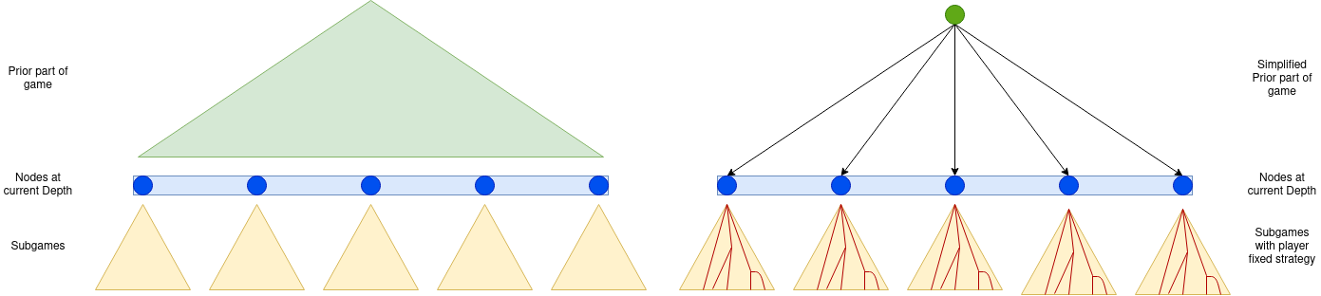
Strategy Refinement
CFR Refinement
CFR Refinement
For each level of the complete game
For each player
Substitute the nodes above the current depth with a single root Chance Node.
Reach probabilities are those specified by the Blueprint.
Fix the strategy of current player in nodes below current depth.
Solve this simplified game using CFR+.
Use strategy of player found at nodes at current depth in final strategy.

Slide 23
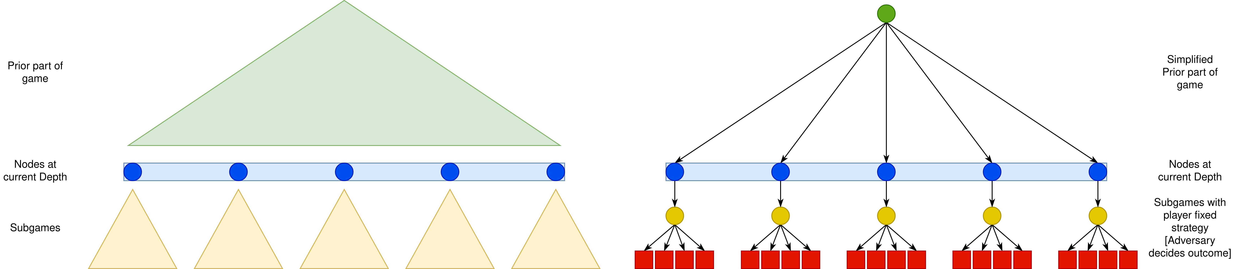
Strategy Refinement
Bias Refinement
Bias Refinement
For each level of the complete game:
For each player:
Substitute the nodes above the current depth with a single root Chance Node.
Fix the strategy of current player in nodes below current depth.
Fix the strategy of adversary to 4 possibilities: Blueprint, Blueprint but probability of Check/Raise/Fold multiplied by 10 at each Decision Node.
Solve this simplified game using CFR+.
Use strategy of player found at nodes at current depth in final strategy.
All strategies are fixed
->
directly compute payoff

Slide 24
Strategy Refinement
Self Generative Refinement
Self Generative Refinement
For each level of the complete game:
For each player:
Do the same as Bias Refinement
BUT
Compute final payoff by computing adversary best response to each of the player strategy, iterating this procedure until a fixed number of payoffs is reached.

Slide 25
Strategy Refinement
In Game Refinement
In Game Refinement
One-Shot refinement: No level-by level approach
Simplify lower subgames by generating possible payoffs in the same way as in Bias Approach.
Refine strategies by using CFR+ on whole remaining tree (= Prior Game + Nodes at Depth limit).
Use found strategy as final strategy in the upper part of the tree, keep blueprint in lower parts.

Slide 26
Strategy Refinement
Conclusions
From the tests we performed on solving Leduc5 games we acknowledged that:
Level by level techniques:
Suffer from Badly scaling Performances due to the level-by-level approach that must repeatedly apply CFR+ for each depth level.
Note that this is true even if in a more simplified game we can use less iterations to reach a good enough Nash Eq.
They are Unsafe due to the fact that adversary may react to a strategy taken by the current player in current depth nodes, by changing his strategy in upper levels. However those have already been considered in previous iterations and so the adversary cannot change its strategy anymore.
This causes an overall Exploitability increase with respect to the use of a blueprint strategy computed on a fine-grained abstraction.
SO we opted for In Game Strategy Refinement since:
Better Performances are guaranteed by the one-shot application of CFR+ to a single tree.
Safeness is theoretically guaranteed [see referenced paper] by biasing some of the computed payoffs.

Slide 27
Conclusions
Final Remarks
SO OUR CHOICES ARE:
Card Binning abstraction
CFR+
In-Game Refinement
OUR RESULTS ON TESTS:
 | Leduc 5 NO ABS | Leduc 5 4 card ABS | Leduc 5 3 card ABS | Leduc 5 2card ABS | Leduc 9 5 card ABS | Leduc 13 5 card ABS
Time Abstraction | - | 0.059 s | 0.065 s | 0.064 s | 0.277 s | 1.036 s
Time Blueprint | 137.18 s | 58.19 s | 24.70 s | 6.90 s | 122.46 s | 171.95 s
Time Refinement | - | 82.76 s | 82.44 s | 81.02 s | 426.30 s | 1405.19 s
Expected Value Blueprint | - | -0.0445 | -0.0205 | -0.0103 | -0.0262 | -0.0595
Exploitability Blueprint | - | 0.246 | 0.452 | 0.741 | 0.224 | 0.213
Expected Value Final | -0.113 | -0.128 | -0.147 | -0.0624 | -0.0874 | -0.0838
Exploitability Final | 0.000241 | 0.168 | 0.288 | 0.357 | 0.0790 | 0.102

Slide 28
Thanks for the attention!

